Slide 1

Student Details
NAME :- siddamsetti veera Venkata Prasanna kumar
ROLL NO :- 21X41A4251
EMAIL :- siddamsettyveeravenkataprasann@gmail.com
College :- s.r.k institute of technology ( Enikepadu, Vijayawada )
Branch :- cse(ai&ml)

Slide 2
steganography
Steganography - Hiding Messages within Images
Problem Statement:
With the increasing need for secure communication, traditional encryption methods are sometimes insufficient to conceal the very existence of a message. Steganography, the practice of hiding messages within other non-secret text or data, offers an additional layer of security. This project aims to develop a steganography tool that allows users to hide text messages within digital images and retrieve them later. The tool should handle high-resolution images efficiently and ensure the hidden messages are not easily detectable.

Slide 3
steganography AGENDA
1.Project overview
2.Software and tools selection
3.Who are the end users of this project?
4.Your solution and its value proposition
5.How did you customize the project and make it your own
6.Modelling
7.Results
8.links

Slide 4
PROJECT OVERVIEW
Project Objectives
The primary objective of this project is to develop a steganography tool that allows users to hide
text messages within digital images and retrieve them later. The tool will focus on the following key
goals:
Message Encoding: Develop a function to encode a text message into an image by manipulating
the least significant bits (LSBs) of the pixel values.
Message Decoding: Develop a function to decode and retrieve the hidden text message from the image.
User Interface : Provide a simple command-line interface for users to input the message to hide or
retrieve.
Efficiency : Ensure the tool can handle high-resolution images without significant performance
degradation.
Compatibility : Handle both RGB and RGBA images to cover a wide range of image formats.

Slide 5
WHO ARE THE END USERS of this project?
The end users of a steganography project, which involves hiding messages within images, can vary depending on its intended application and audience. Here are several potential end users who might find such a tool useful:
Security Professionals:
Penetration Testers: Use steganography to assess the vulnerability of systems and networks to covert data transmission.
Cybersecurity Analysts: Employ steganography to investigate potential data exfiltration techniques used by malicious actors.
Law Enforcement and Intelligence Agencies:
Investigators: Utilize steganography tools to uncover hidden messages in digital images during forensic investigations.
Intelligence Analysts: Use steganography to transmit covert messages securely within digital media.
Journalists and Whistleblowers:
Journalists: Employ steganography to securely communicate sensitive information or protect the identities of sources.
Whistleblowers: Use steganography to hide evidence within images when disclosing confidential or sensitive information.
Educational and Research Institutions:
Students: Study steganography as part of computer science, cybersecurity, or digital forensics courses.
Researchers: Conduct experiments and studies on steganography techniques and applications.
General Public:
Technology Enthusiasts: Explore and experiment with steganography as a hobby or interest in digital security and cryptography.

Slide 6
YOUR SOLUTION AND ITS VALUE PROPOSITION
Value Proposition:
Enhanced Security:
Secret Key Encryption: The use of a secret key adds a layer of security, ensuring that only individuals with the correct key can decode the hidden message.
XOR Operation: The XOR operation provides a simple yet effective means of obfuscation, making it difficult to detect the hidden message without the key.
Data Confidentiality:
Hidden in Plain Sight: The message is embedded within the image pixels, making it invisible to the naked eye and hidden from standard image inspection methods.
Secure Communication: Enables secure communication of sensitive information, ideal for scenarios where privacy is crucial.
Versatile and User-Friendly:
Broad Applications: Suitable for various applications, including cybersecurity, journalism, and personal privacy.
User Interaction: Simple prompts guide the user through the process of encoding and decoding messages, making it accessible even to those with limited technical expertise.
Efficiency:
Minimal Overhead: The process of encoding and decoding messages is computationally efficient, adding minimal overhead to the image processing.
Portable: The encoded images can be easily transmitted and stored without noticeable changes in appearance.
Scalability:
Variable Message Length: The system can handle messages of varying lengths, limited only by the size of the image.
Adaptable Key Length: The key can be of any length, providing flexibility and increased security through longer keys.

Slide 7
How did you customize the project and make it your own
Algorithm selection and modification:
The choice of steganographic algorithm was carefully considered based on its suitability for embedding data within various media types.
USER INTERFACE DESIGN:
The user interface (UI) was customized to ensure ease of use and intuitive interaction.
INTEGRATION OF ADDITIONAL FEATURES:
Additional functionalities were integrated to extend the utility of the application beyond basic steganographic operations.
TESTING AND VALIDATION PROCEDURES:
Rigorous testing procedures were customized to validate the accuracy and reliability of the steganographic techniques employed.
DOCUMENTATION AND REPORTING:
Detailed documentation was customized to provide comprehensive insights into the project’s development process.

Slide 8
MODELLING
1. Data Representation:
Text to ASCII Mapping: The text to be hidden is represented using its ASCII values.
Dictionaries: Two dictionaries, d and c, map characters to their ASCII values and vice versa.
2. Image as Data Container:
The image is read and treated as a matrix of pixel values, where each pixel has three color channels (Red, Green, Blue).
The dimensions of the image (height, width, number of color channels) are extracted to ensure proper navigation through the image matrix.
3. Security Key:
User Input: The user provides a security key which is used to XOR the ASCII values of the text characters.
4. Encoding Process:
Initialization: Initialize variables to navigate through the image and the text.
XOR Operation: Each character of the text is XORed with each character of the key, and the result is stored in the image’s pixel values.
5. Decoding Process:
Verification: The user provides a key to decode the hidden message. The key is verified before decoding.
XOR Operation: The stored values in the image are XORed with the key to retrieve the original ASCII values of the text.
6. User Interaction:
The user is prompted to provide inputs for the security key and the text to hide.
The user is prompted again to provide the key to unhide the text, ensuring that only those with the correct key can retrieve the hidden message.

Slide 9
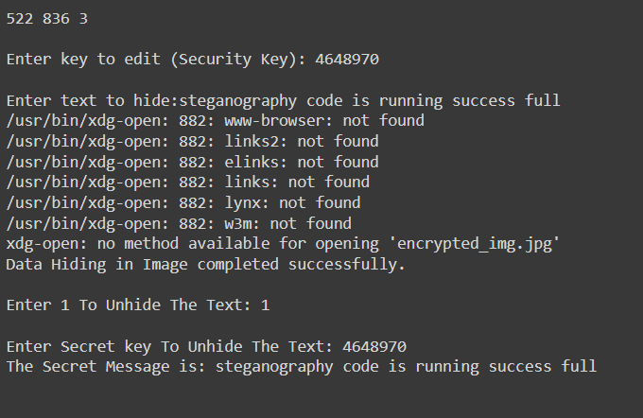
Results
We can protect our text inside the image by keeping an secure password.
By entering the password we can get the text hided inside the pic
In above image we can see the secret message (“steganography code is running success full”)
that had to be hided inside the image.
And also a password to protect our text.
By entering the password we can get the text hided inside the image

Slide 10
links
https://github.com/siddamsettiveeravenkataprasannakumar/Steganography-for-hidetext.git

Slide 11
THE END

